Slide 1
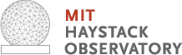

Introduction to Radio Astronomy
Vincent L. Fish

Slide 2
Outline
Theory
Basics of radio antennas
Introduction to interferometry
Fringes, visibilities, and aperture synthesis
Application
An example of interferometric imaging
Science
Geodesy
Spectral line astronomy
Radio frequency interference
Polarization
Other resources

Slide 3
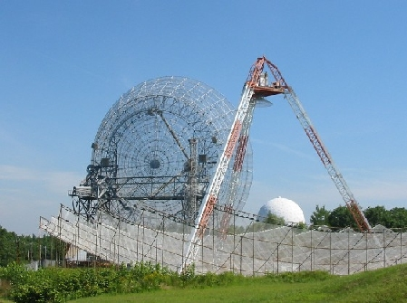
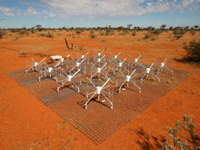
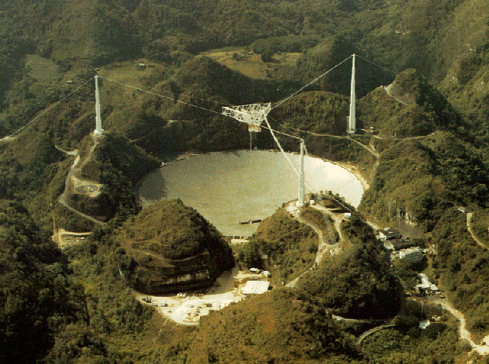
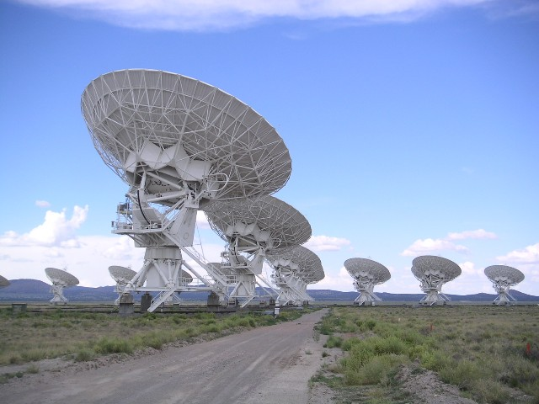
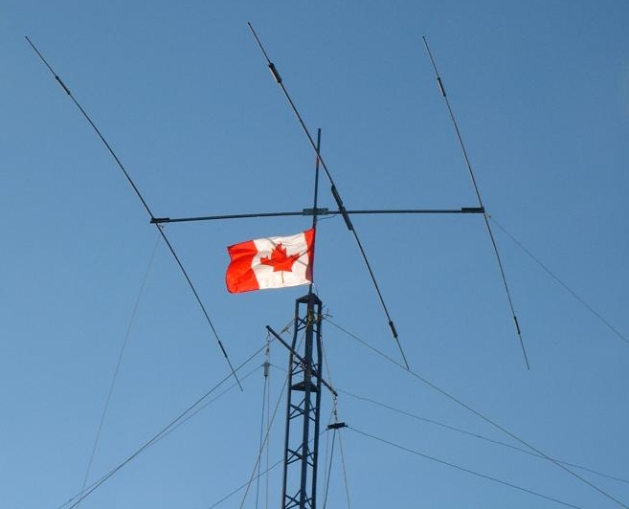
The many forms of radio antennas
Dipoles
Yagis
Dishes (parabolic, spherical)
...
Single elements
Arrays

Slide 4
Radio waves and antennas
Radio signals from astronomical sources are weak Typical unit of flux density is the Jansky (Jy) 1 Jy = 10⁻²⁶ W m⁻² Hz⁻¹ = 10⁻²³ erg sec⁻¹ cm⁻² Hz⁻¹ units: energy flux per unit bandwidth
Radio waves, like all electromagnetic waves, contain an oscillating electric field
Radio antennas focus and sense this electric field E = A cos(ωt + ϕ) and convert it to a voltage
Radio antennas measure both the amplitude and the phase of incoming radiation
Measured quantity is power (proportional to square of voltage)

Slide 5
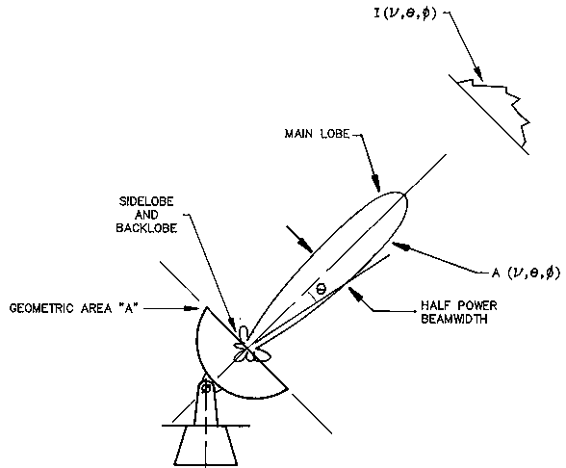
Beam size
The response of an antenna to sources as a function of position on the sky is characterized by its beam pattern, also called the primary beam
For a circular parabolic reflector, the size of the main lobe in radians is approximately λ/D, where λ is the wavelength of radiation and D is the diameter of the telescope
Sidelobes contaminate observations by adding noise from ground, blank sky, bright sky sources
Better resolution requires either shorter wavelength (higher frequency) or bigger telescope
GBT (100 m) beamsizes: 12.6 arcmin @ 1 GHz 17.5 arcsec @ 43 GHz
Much higher resolution requires interferometry

Slide 6
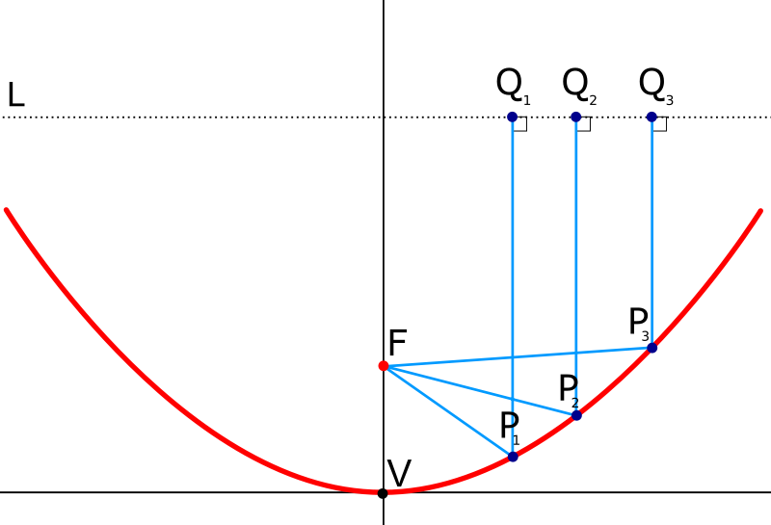
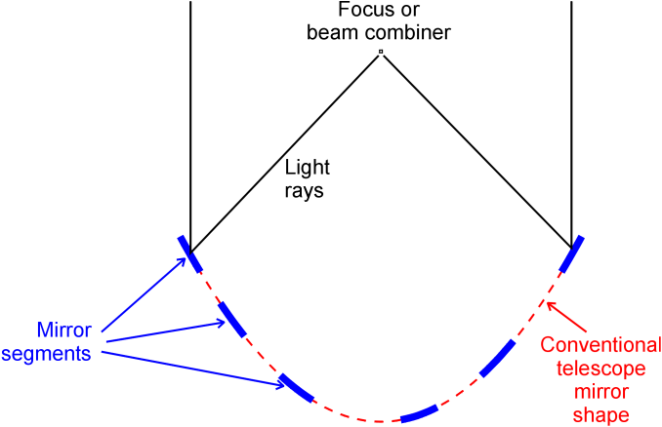
The concept behind an interferometer
The important property of a parabolic dish is that it adds parallel light rays coherently
Parallel rays (from infinity) have equal path lengths to the focus, so they all arrive in phase
This is still true if we remove segments of the parabola – remaining rays still reach focus in phase
Now imagine moving the remaining segments of the dish off the surface of the paraboloid
So long as we know very precisely where the segments are located, we can delay their signals appropriately and still add them together coherently
This, in essence, is what an interferometer does
Images: wikipedia

Slide 7
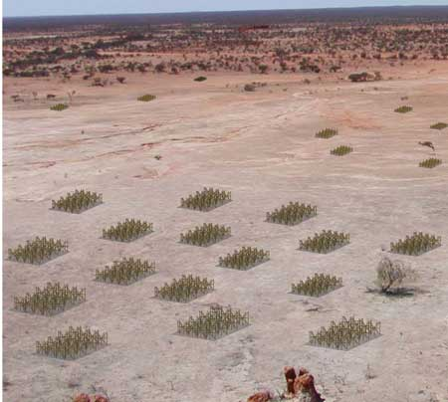
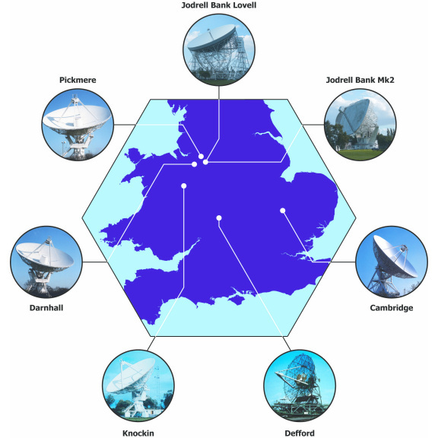
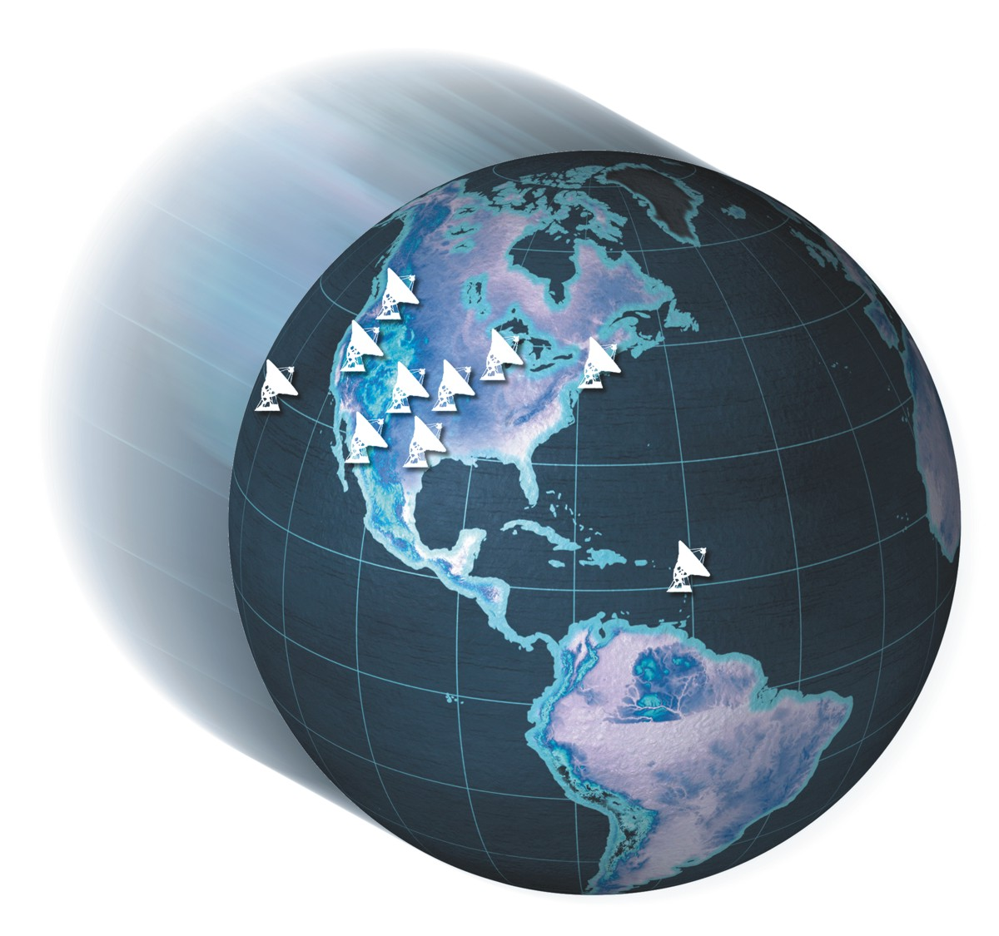
Interferometers
Baseline lengths range from very short to Earth-scale (or larger!)
Antennas can be connected by wires, fibers, or microwave links
Some arrays aren't connected at all – very long baseline interferometry (VLBI)

Slide 8
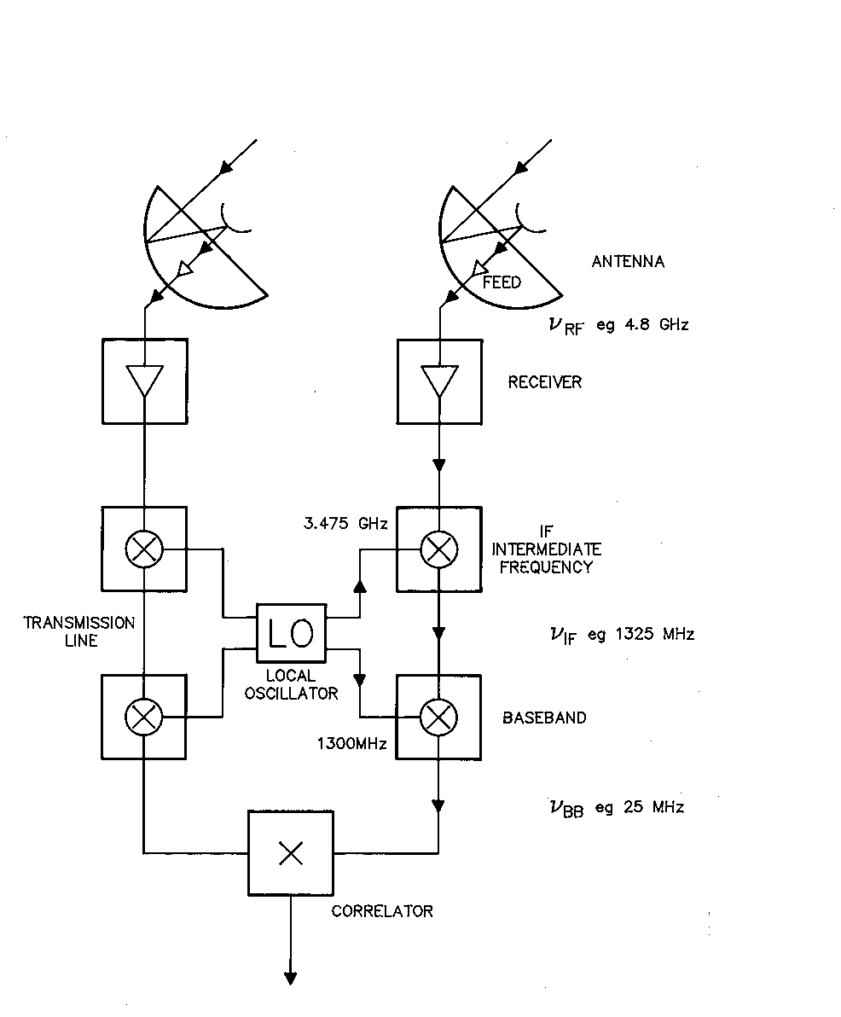
Antenna/inteferometer signal path
At high frequencies, signal cannot be sampled at radio frequency (RF, the frequency of observations)
Radio frequencies can be mixed with pure tones to change their frequency – heterodyne
Mixing produces intermediate frequency (IF)
cos θ cos ϕ = ½ [cos (θ – ϕ) + cos (θ + ϕ)]
Unwanted component is filtered out
Mixing allows the same back-end instruments to be used regardless of RF
Traditionally all signal processing has been analog, but future is digital

Slide 9
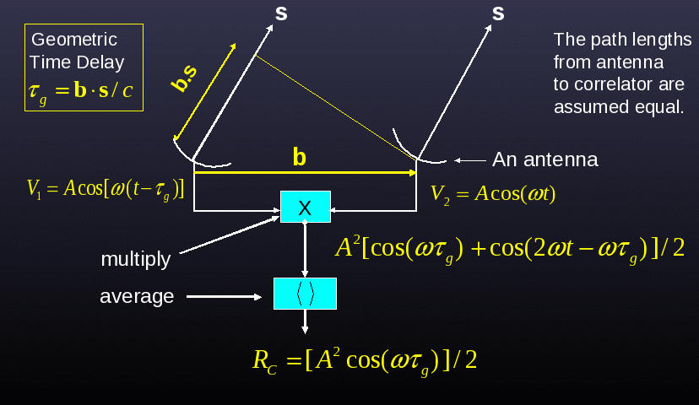
How interferometry works
Two different antennas looking at same source – one will experience time delay
Multiply and average signals to recover amplitude and delay/phase
R_{C} depends on source strength, position on sky, and baseline
Monochromatic interferometer looking at a continuous wave
In practice, add delay at red dot
Figure courtesy Rick Perley (NRAO)

Slide 10
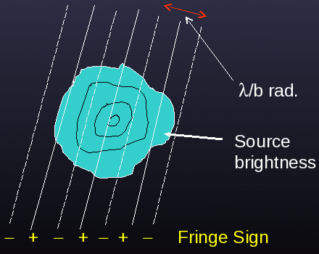
Fringe pattern
Baseline effectively projects sinusoidal fringe pattern on sky
Fringes are lines of equal delay
τ_{g} = b·s/c, so ωτ_{g} = 2πνb·s/c = 2πb·s/λ (angular frequency ω = 2πν; c = λν)
Fringe spacing is λ/b, where b is the projected baseline length (i.e., the length of the baseline as viewed from the source)
R_{c} = ∫∫ A(s) I(s) cos(2πνb·s/c) dΩ, A(s) = antenna response
Cosine is even, so we need another correlation to measure arbitrary sky emission
R_{S} = ∫∫ A(s) I(s) sin(2πνb·s/c) dΩ
Sine correlation obtained in exactly the same way as the cosine correlation, except with 90° phase shift on one antenna
stripes, basically
Figure courtesy Rick Perley (NRAO)

Slide 11
Visibilities
We can combine the cosine and sine correlations into a complex visibility
R_{c} = ∫∫ A(s) I(s) cos(2πνb·s/c) dΩ
R_{S} = ∫∫ A(s) I(s) sin(2πνb·s/c) dΩ
V = R_{c} – iR_{S} = ∫∫ A(s) I(s) e^{–2πiνb·s/c} dΩ i = sqrt(-1)
This equation can be inverted to solve for the intensity distribution
Define unit cosines l, m, n and baseline coordinates u, v, w (basically, east, north, and up measured in units of wavelength)
b·s/λ = ul + vm + wn = ul + vm + w(1 – l² – m²)^{1/2}; dΩ = dl dm (1 – l² – m²)^{1/2}
Except for wide-field imaging, w(1 – l² – m²)^{1/2} is small, can be assumed constant
Then V(u,v) = ∫∫ A(l,m) I(l,m) e^{–2πi(ul+vm)} dl dm
and A(l,m) I(l,m) = ∫∫ V(u,v) e^{+2πi(ul+vm)} du dv
Visibilities and sky intensity related to each other by a Fourier transform – get a lot of visibilities in the (u,v) plane and you can reconstruct the image
No relation to other senses of the word!

Slide 12
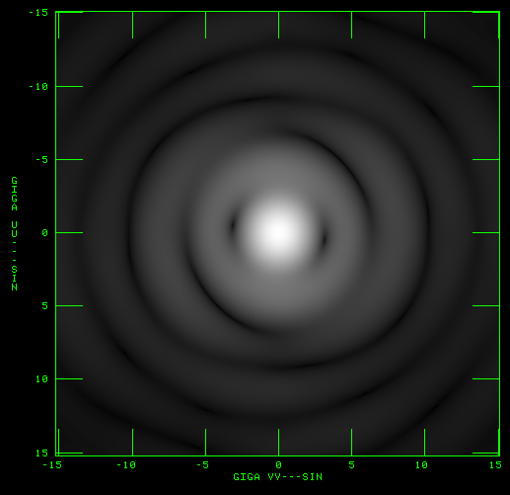
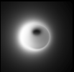
Fourier transform in action
At any given time, each baseline samples the Fourier transform of the sky emission at a point in (u,v) space
In the absence of noise, calibration errors, etc., the measured visibility (amplitude + phase) is one Fourier component of the sky image
Note: a visibility does not pick out one “pixel” of the sky image!
A visibility is sensitive to all pixels, which is why we need a lot of them to reconstruct the image
Model sky image
Fourier transform (amplitude)

Slide 13
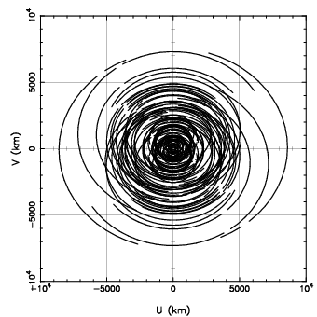
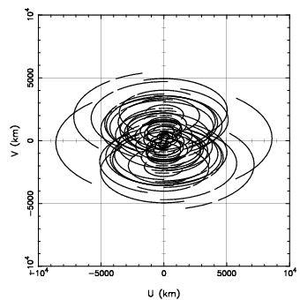
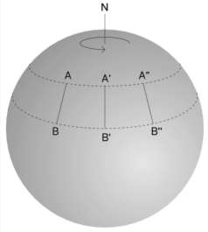
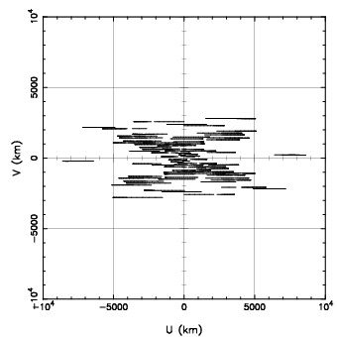
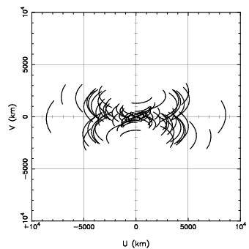
Earth rotation aperture synthesis
As the Earth rotates, the (u,v) coordinates of baselines change, sweeping out arcs in the (u,v) plane
Dec 60°
Dec 30°
v (baseline coordinate)
Dec 0°
Dec –30°
u (baseline coordinate)

Slide 14
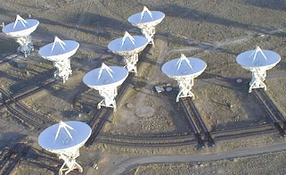
Properties of interferometers
An interferometer acts as a spatial filter Baseline fringe spacing is (u²+v²)^{-1/2} rad (π rad = 180°)
Short baseline: wide fringe spacing = low angular resolution
Long baseline: fine fringe spacing = high angular resolution, but “resolves out” large-scale emission
It is important to match the baseline lengths of an interferometer to the spatial scale of interest – this is why some arrays move their telescopes
Longest baselines of VLA configurations A: 36 km B: 11 km C: 3.4 km D: 1 km

Slide 15
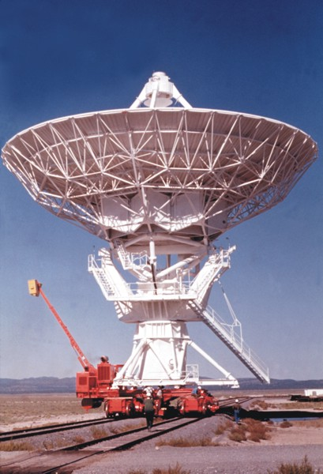
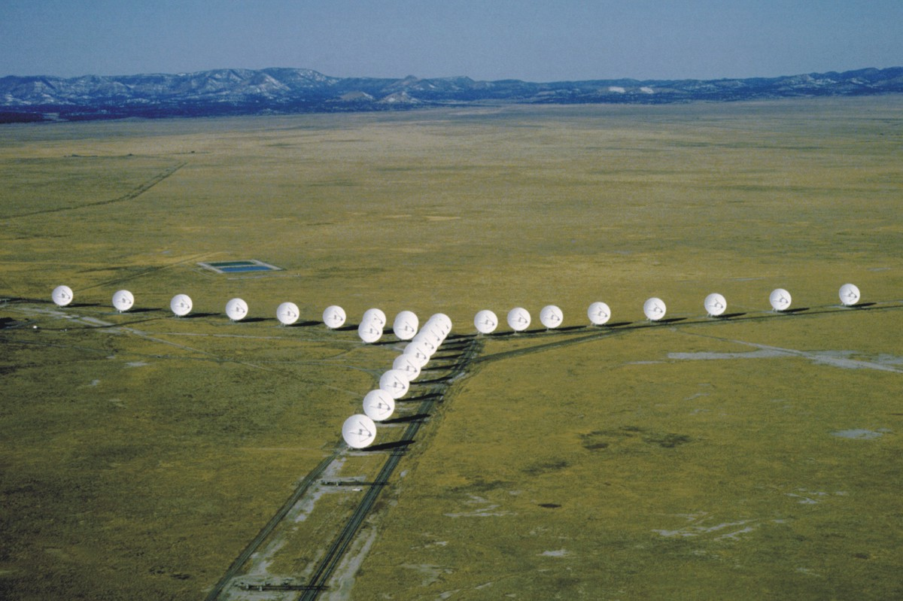
Interferometric imaging 1: Introduction
Example:
Observations of 3C268.4 (quasar) with VLA in A-configuration (most extended)
ν = 8.43 GHz / λ = 3.56 cm
Data and figures courtesy Colin Lonsdale & Divya Oberoi (pictures courtesy NRAO)
Transporter
VLA D-configuration

Slide 16
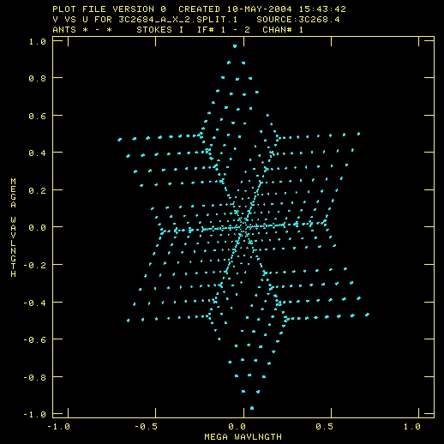
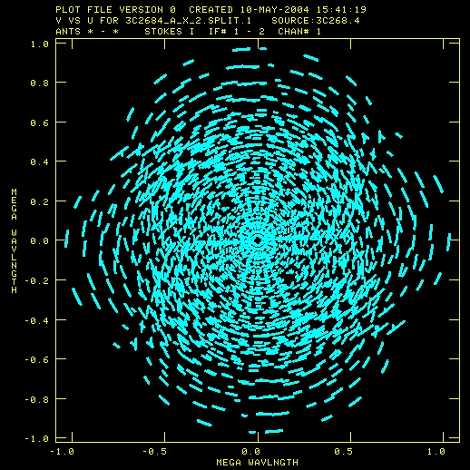
Interferometric imaging 2: (u,v) coverage
VLA has good instantaneous (u,v) coverage suitable for “snapshot” imaging
General fact: V(–u,–v) = V*(u,v) – follows from fact that sky is real, not complex
These observations occurred over the course of 7 hours
Multiple scans on same source give even better (u,v) coverage
35.6 km

Slide 17
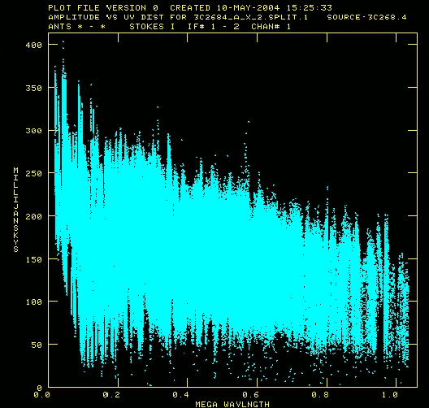
Interferometric imaging 3: Visibility amplitudes
Plot of visibility amplitudes versus (u,v) distance
Maximum (u,v) distance ~ 10⁶, so fringe spacing ~ 1/10⁶ rad = 0.2 arcsec
Many shorter spacings as well
Flux density of source is a few tenths of a Jy
Amplitudes fall off with (u,v) distance: Source is partially resolved (There is power on scales larger than 0.2 arcsec)
Comparison: Typical FM station (0.1 W Hz⁻¹) placed at 1 AU would be a 35 Jy source
(u² + v²)^{1/2}

Slide 18
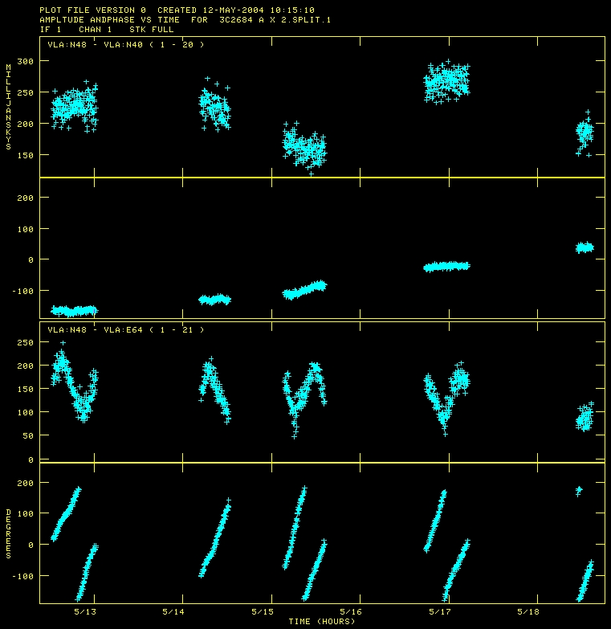
Interferometric imaging 4: Calibration and visibilities
In general, visibilities must be “calibrated” to take out atmospheric, ionospheric, and instrumental effects
Effectively this means solving for complex gains (amplitude & phase) for each antenna as a function of time
For weak sources, observe nearby bright calibrator (e.g. quasar) and transfer solutions
For bright sources, the visibilities can be self-calibrated because the data are highly overconstrained: e.g., VLA: n = 27 antennas, 0.5 n (n-1) = 351 baselines
Calibrated visibilities can then be used to form an image
Amplitude
Short baseline (1.4 km)
Phase
Amplitude
Long baseline (18.9 km)
Phase
Time

Slide 19
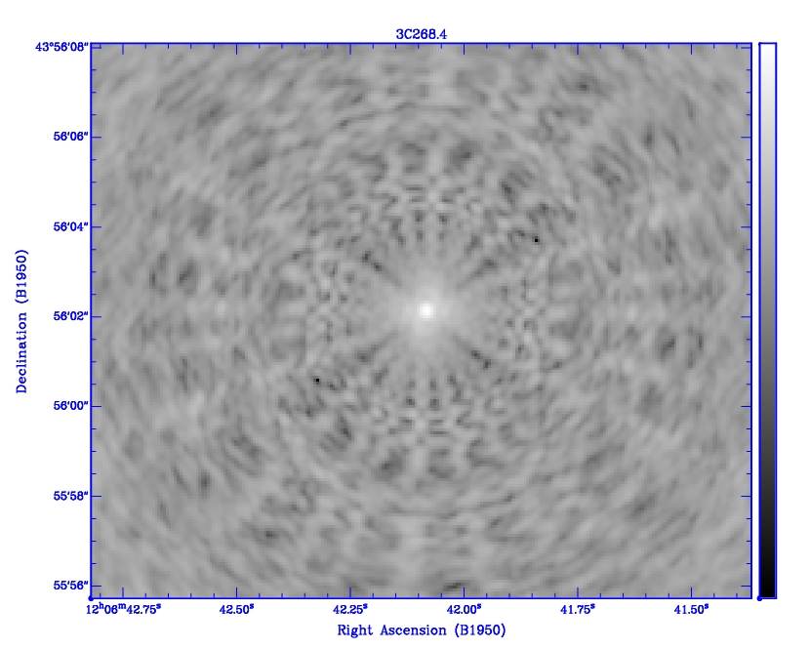
Interferometric imaging 5: The dirty beam
The dirty beam, also known as the point-spread function, is the response of the array to a point source
Because the (u,v) plane is incompletely sampled (out to a certain radius), a point source will have ugly (but predictable!) sidelobe structure dependent on the (u,v) coverage of the observations

Slide 20
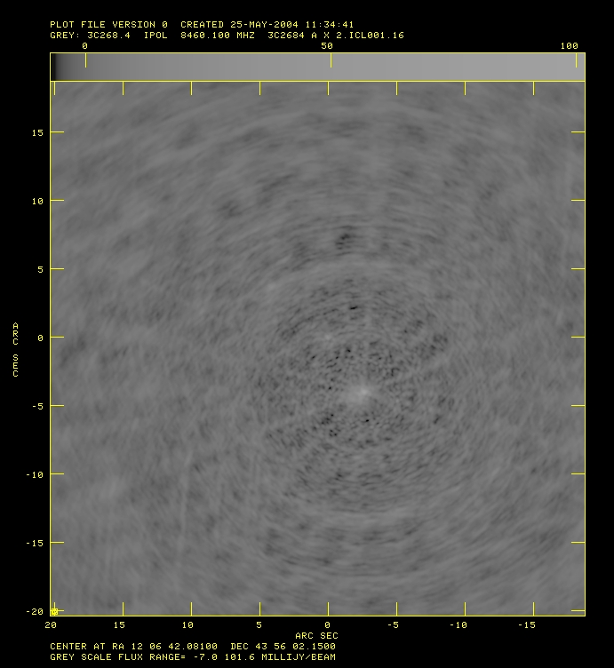
Interferometric imaging 6: The dirty map
We can take the Fourier transform of the visibilities to produce the dirty map, which is a representation of the sky convolved with the dirty beam
To obtain a good map of the emission from the sky, we must deconvolve the image

Slide 21
Interferometric imaging 7: Deconvolution
There are several deconvolution algorithms, of which the most popular (and historically most important) one is CLEAN
Applying the CLEAN algorithm to the dirty map: 1. Find brightest pixel (positive or negative) 2. Multiply dirty beam by value of this pixel and the loop gain (0 < gain < 1) and subtract from image, making note of flux and position 3. Go back to #1 unless one of the stop criteria applies 4. Take residual map and add point sources from list in #2
CLEAN can be stopped when the number of iterations exceeds a pre-specified value, the brightest pixel < some value (noise), or the brightest pixel < some fraction of the peak in dirty map (dynamic range)
CLEAN works well when image is composed of a small number of point sources (or sources with small finite extent); extended areas of emission appear blotchy
Alternatives: maximum entropy, multi-scale CLEAN, ...

Slide 22
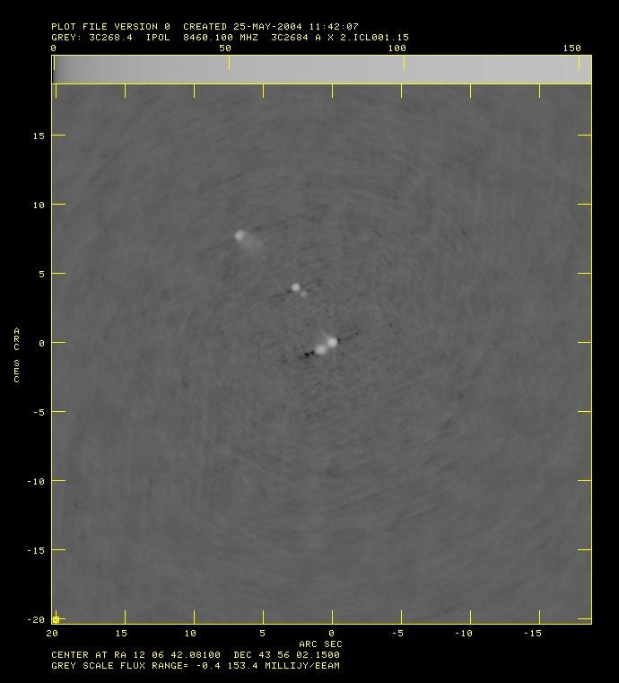
Interferometric imaging 8: The CLEAN map
Even after CLEAN, some sidelobe artifacts may remain
Before CLEAN
After CLEAN

Slide 24
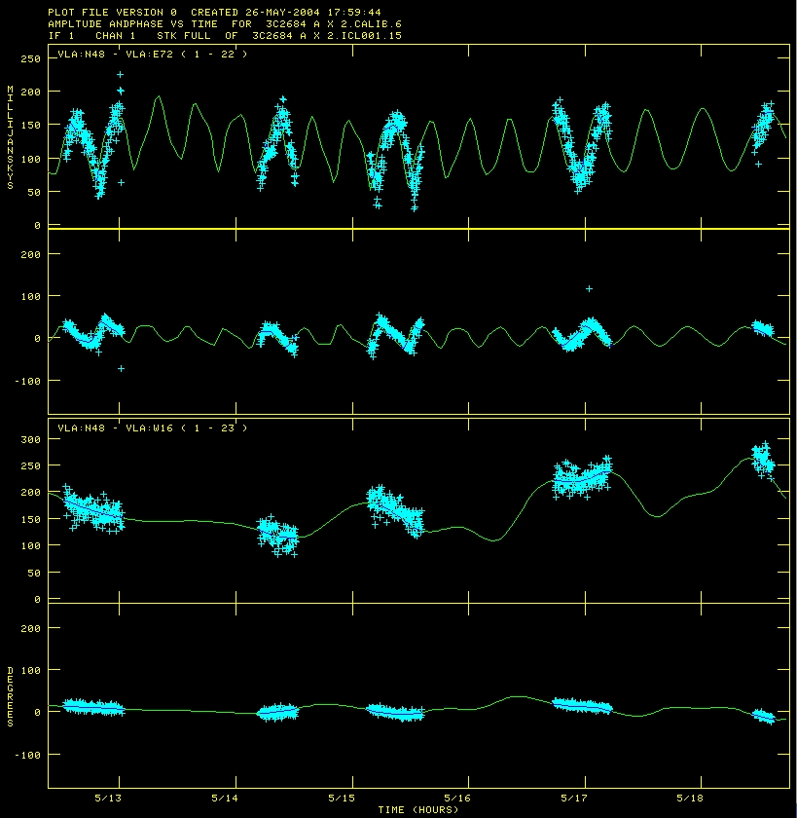
Interferometric imaging 10: Incomplete data
CLEAN and self-calibration make assumptions about the source structure, which is equivalent to extrapolating data over the gaps
Deconvolution is nonunique!
The larger the gaps in your (u,v) coverage, the poorer your final map will be
CLEAN model

Slide 25
Antenna positions
For inteferometry, the positions of radio antennas must be known to a fraction of a wavelength, although they can be solved for a posteriori if their positions are known approximately
If the telescope position is inaccurate, or if the astronomical source is not located at the correlation center, there will be a diurnal variation of the delay from model predicted values
If telescope positions are precisely known, VLBI observations can be set up to determine the absolute positions of sources in the sky – astrometry
The problem can also be inverted: If source positions are known to sufficient accuracy, telescope locations can be derived – geodesy
“Fixed” telescopes move (e.g., plate tectonics), the Earth wobbles, and the day length is not constant!

Slide 26
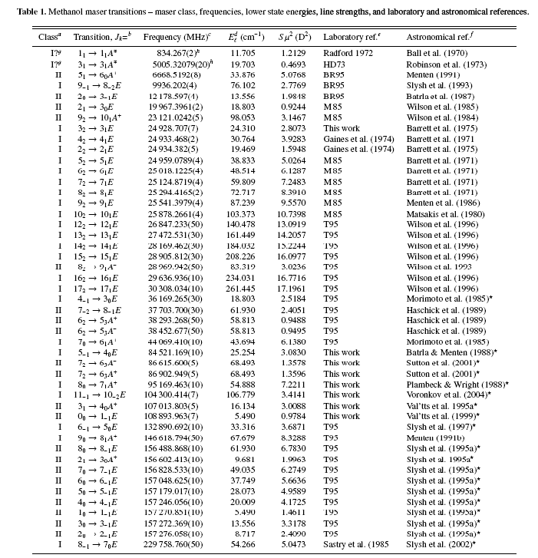
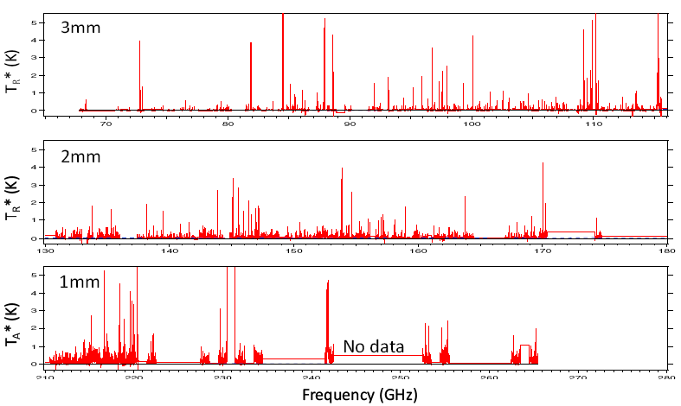
Spectral lines 1
Some emission processes produce continuum emission (e.g., synchrotron, free-free), while others (especially molecules) produce spectral lines
Each molecule emits/absorbs at a very specific set of frequencies – these frequencies can be approximated from quantum mechanical simulations but require laboratory measurement for high precision
Just a few of the many methanol transitions (Müller et al. 2004)
Spectral line survey of Sgr B2(N) (Halfen & Ziurys 2008)

Slide 27
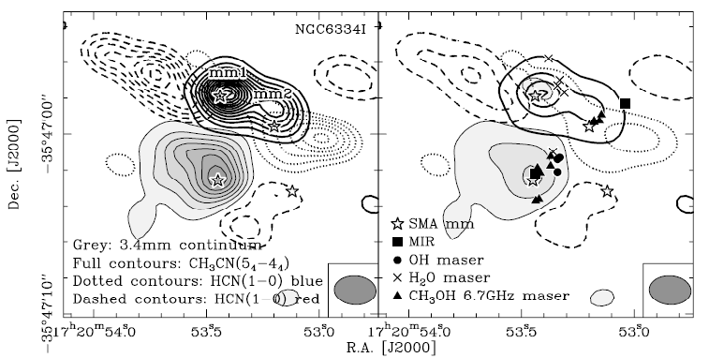
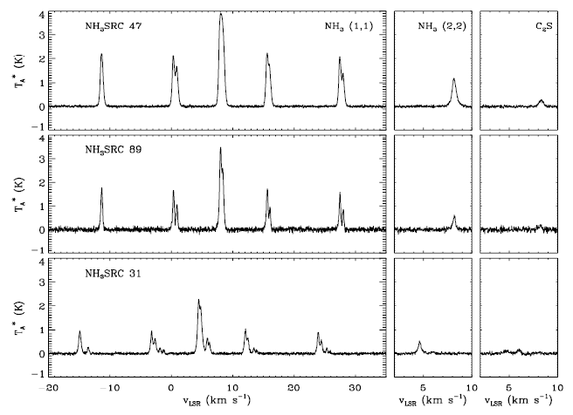
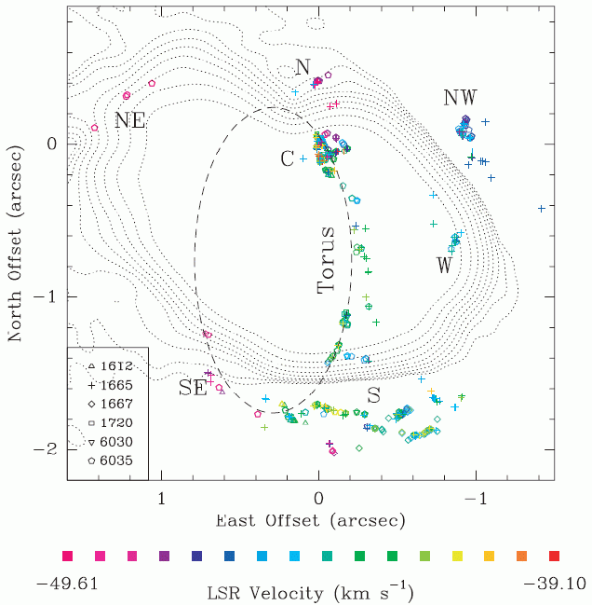
Spectral lines 2
Astronomical molecules are studied for many reasons: astrochemistry physical conditions (T, ρ, ...) environmental tracers (outflows, massive star formation, ...) velocity structure probes of magnetic field
Velocity resolution much greater than in optical/IR
Beuther et al. 2008
Fish & Sjouwerman 2007
Rosolowsky et al. 2008

Slide 28
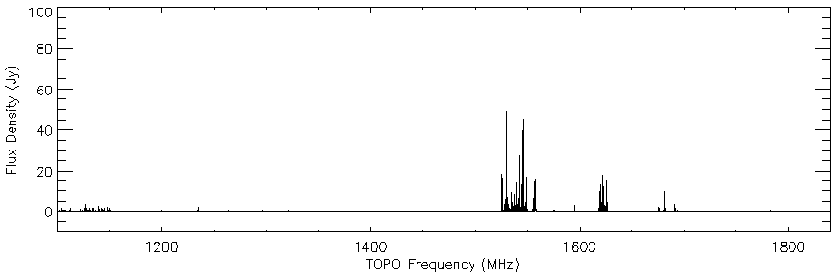
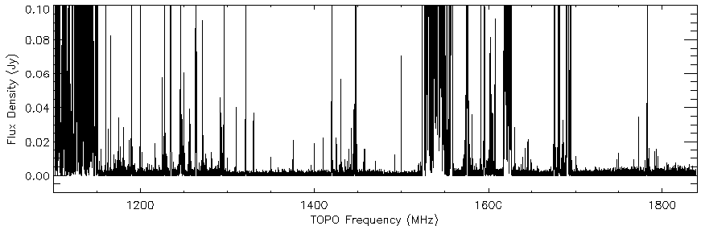
Interference
Radio frequency interference (RFI) is a real problem these days
Not too bad for VLBI, since RFI doesn't correlate, but horrible for single dishes
GBT
RFI plot
Same plot
x 1000

Slide 29
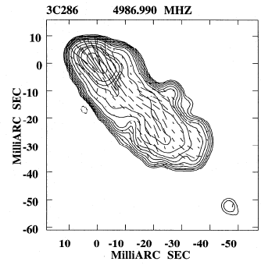
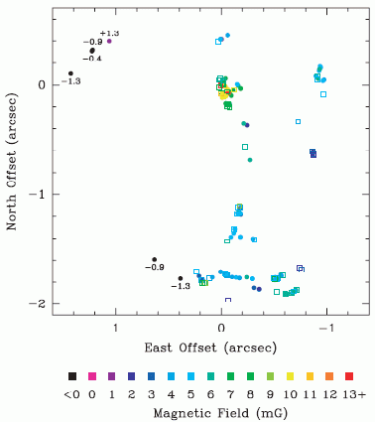
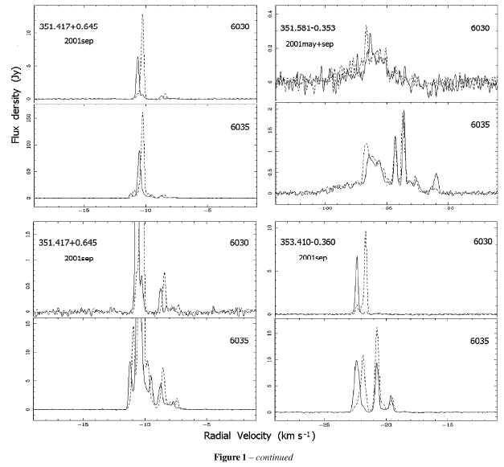
Polarization
A radio feed is only sensitive to one polarization
Feeds can be sensitive to linear or circular polarization
If both polarizations (horizontal & vertical linear or left & right circular) are observed simultaneously, the signals can be cross-correlated to obtain full polarimetric data
Most radio sources are unpolarized, but some have linear polarization (e.g., quasar jets), while others have elliptical/circular polarization (e.g., OH masers)
Jiang et al. 1996
Fish & Sjouwerman 2007
Caswell 2003

Slide 30
Resources for further information
The Haystack community
The library Tools of Radio Astronomy: Rohlfs & Wilson Radio Astronomy: Kraus Interferometry and Synthesis in Radio Astronomy: Thompson, Moran, & Swenson (advanced)
The web
NRAO's radio astronomy pages (general overview) NRAO's Synthesis Imaging Workshop lectures (very detailed)

